Slide 1

Inheritance - Abstract Classes
M1-D13
Participate! The more engagement the better! You are NEVER interrupting me!

Slide 2
Objectives
Final Methods and Classes
Abstract Methods and Classes
Protected Access Modifier
Intro to Testing (to make tomorrow easier)

Slide 3
What if we implement a method in the parent class, and want to make sure the child class can’t override it OR….
What if we want to make sure a class can’t be overridden?

Slide 4

Final Classes and Methods

Slide 5
Final Methods and Classes
The final modifier can be used with methods and classes to control how they are used.
A final method cannot be Overridden.
public final String myMethod(){ }
A final Class cannot have subclasses.
public final class myClass { }

Slide 6
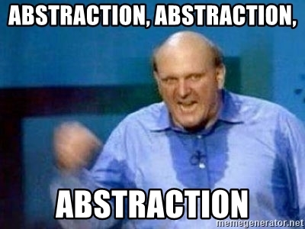
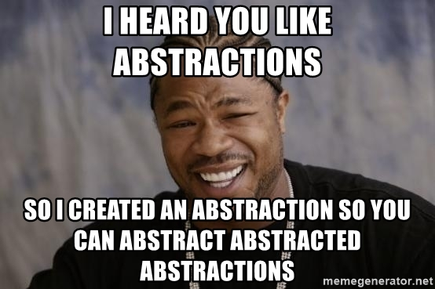
Abstract Classes

Slide 7
Abstract Class
An abstract class cannot be instantiated and exists solely for the purpose of inheritance and polymorphism.
Like a combination of an interface and a superclass.
Can extend it like a superclass
Can inherit implementation from it like a superclass
Can provide method signatures that must be implemented like an interface
A class can only extend either 1 abstract class or 1 superclass, but may implement multiple interfaces.

Slide 8
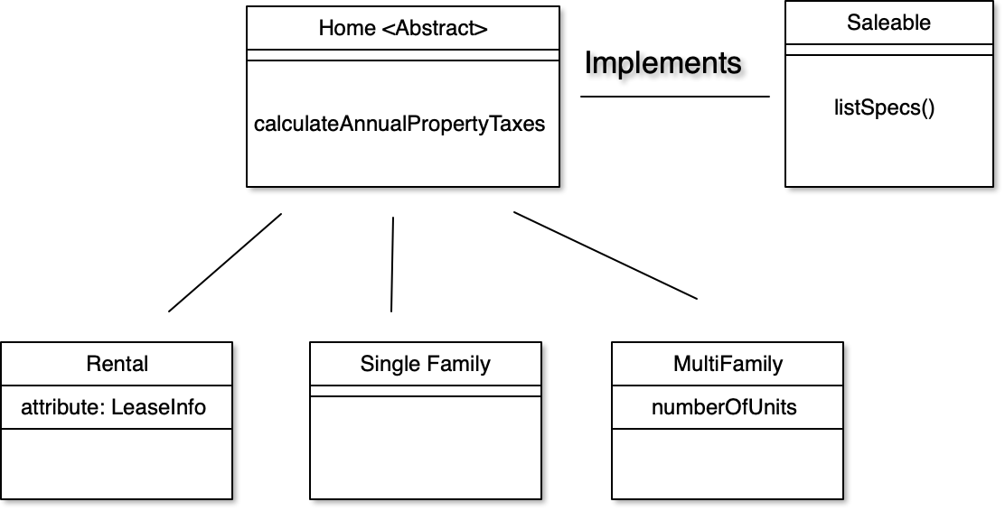
Abstract Class
We can’t instantiate one of these….
But we can instantiate any of these.

Slide 9
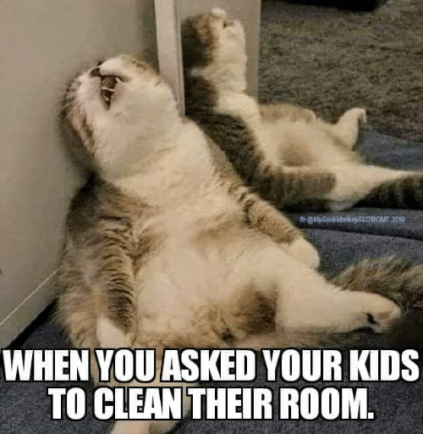


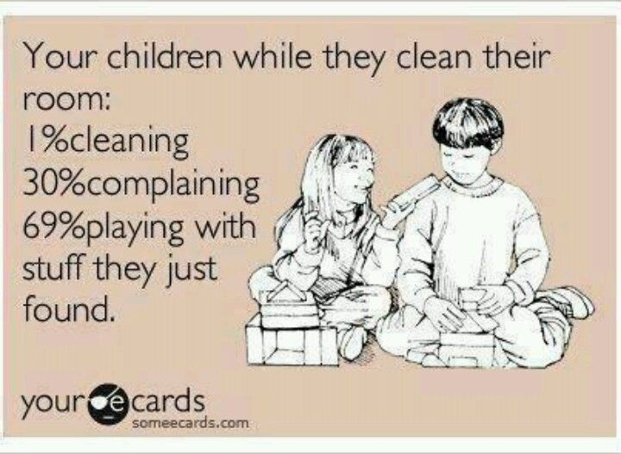
Abstract Methods

Slide 10
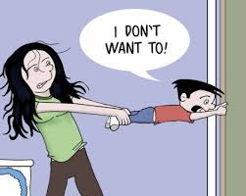
Abstract Method
A method signature with the abstract modifier. Can only exists in an abstract class, and must be overridden in any implementation class that extends the abstract class.
public abstract BigDecimal calculateAnnualPropertyTax(double taxRate);
TL;DR: Methods marked abstract must be overridden by subclasses.

Slide 11
Real Life Example:
<Abstract>Service abstract ResponseMsg execute(RequestMsg request)
-Logging/Compliance -Authentication -Monitoring Hooks (COMMON FUNCTIONS)
extends
extends
BalanceInquireSvc execute(request) { //return account balances }
CustomerLookupSvc execute(request) { //return customer info
}

Slide 12
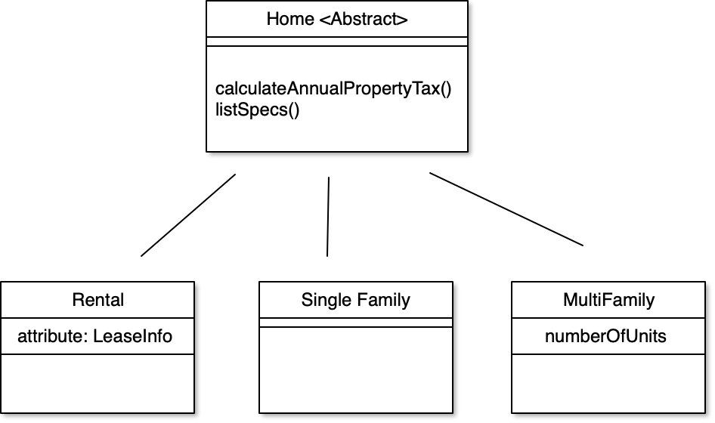
Abstract Methods
Let’s make these methods abstract and get rid of the interface
So we can guarantee this get’s implemented in our subclasses
calculateAnnualPropertyTax() listSpecs()
calculateAnnualPropertyTax() listSpecs()
calculateAnnualPropertyTax() listSpecs()

Slide 13
What are some differences and similarities between interfaces and abstract classes?
Common Interview Question

Slide 14
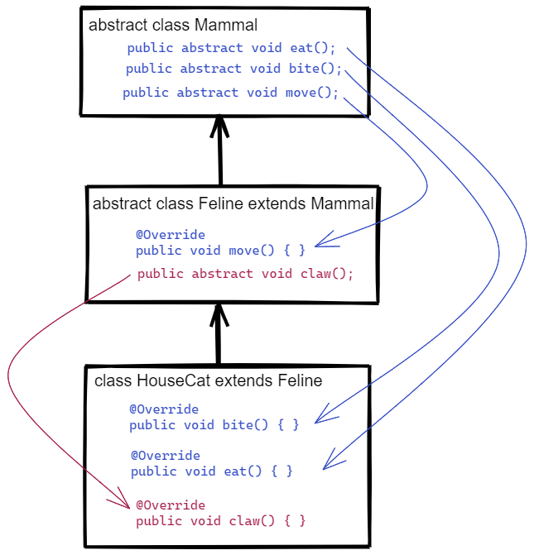
Abstract Method Transitivity
If an abstract class extends another abstract class, then it can choose to implement the abstract method or do nothing and pass it on to the class that extends it.
All abstract methods must have an implementation by the time the class is instantiated.

Slide 15
Reasons to use an Abstract Class
To prevent a superclass from being instantiated.
For example: Having a Generic “Feline” as an object may not make sense, so by making Feline abstract it forces the user of the class to instantiate the more concrete HouseCat or Lion objects that are subclasses of Feline.
When you need to have the ability to inherit functionality from a superclass and force a subclass to implement subclass specific methods.
Abstract classes should only represent a IS-A relationship (a Car IS-A Vehicle) and never a HAS-A relationship (a Car HAS-A Drivable)
This same need can also be accomplished by using a combination of a superclass and interfaces.

Slide 16
Protected and Default Access Modifiers
Private - accessible only in the class
can be applied to methods and member variables
Protected - accessible in the class and in any subclasses in the inheritance tree.
can be applied to methods and member variables
In Java, protected it also available to any class in the same package, but this use is discouraged.
Default (no access modifier) - accessible to any class or subclass in the same package.
can be applied to methods and member variables
Public - accessible everywhere
can be applied to methods, member variables, classes, and interfaces)
Java Accessors Cheatsheet

Slide 17
When to use each accessor
Public is for “set in stone” methods that you want other programmers to rely on to use your object. These create the behaviors of the object, but changing their method signatures may break other code that is using your object.
Protected is for building connections between inherited classes. It lets you have methods in a superclass that are accessible to the subclasses, but does not allow access outside the hierarchy.
Private is for methods that are only for use inside the class itself.
Default should generally be avoided.
Class design should include how others will use your object, the methods that allow that use should be public. All other methods and variables should be private, until needed in the hierarchy or publically. So if you are unsure, start as private and increase the access as needed.

Slide 18
OO Programming in 2-3 minutes (approximately)

